Slide 1
Cruise excursion booking system

Slide 2
content
Introduction
Diagrams
Demonstration

Slide 3
PROJECT TEAM
1
2
3
4
JENISH TAMRAKAR
SUSAN TAMRAKAR
RAJESH RAI
SANIL SHRESTHA

Slide 4
INTRODUCTION
Onboard excursion booking system
Offers booking service for excursion
two types of users are allocated Admin and Client.
32 seats for each coach

Slide 5
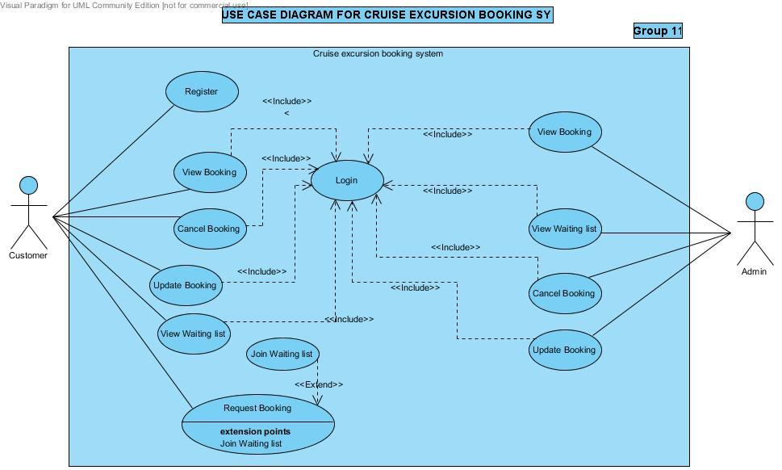
USE CASE DIAGRAM

Slide 6
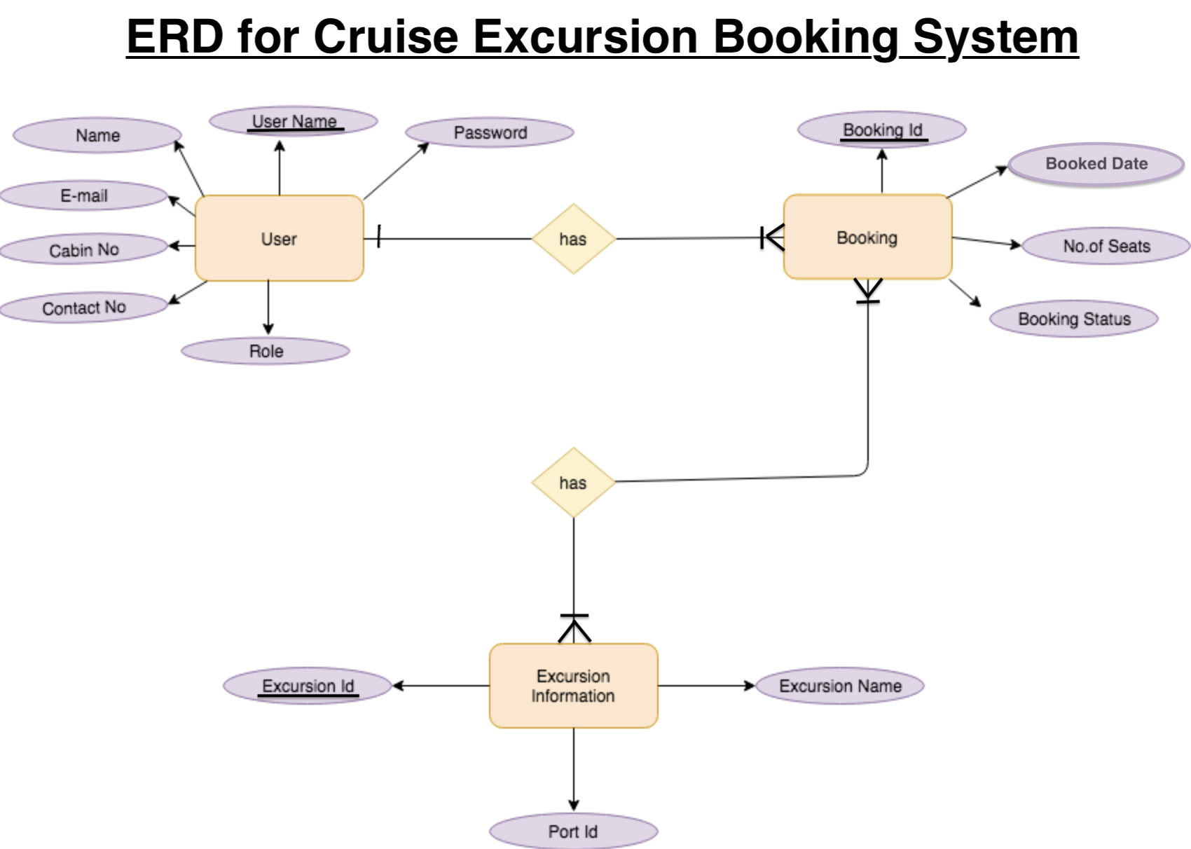
ENTITY RELATION DIAGRAM

Slide 7
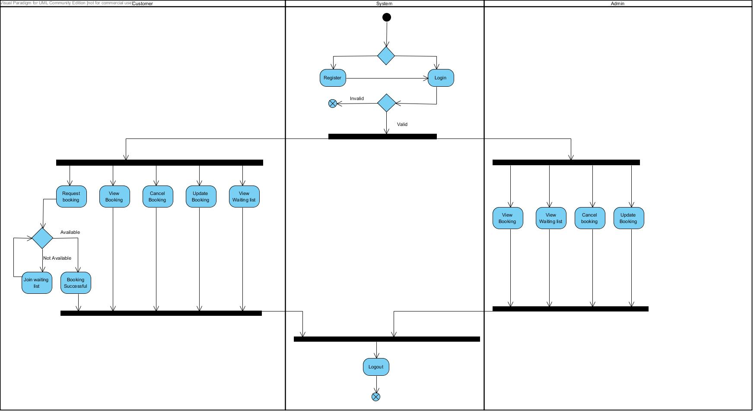
ACTIVITY DIAGRAM

Slide 8
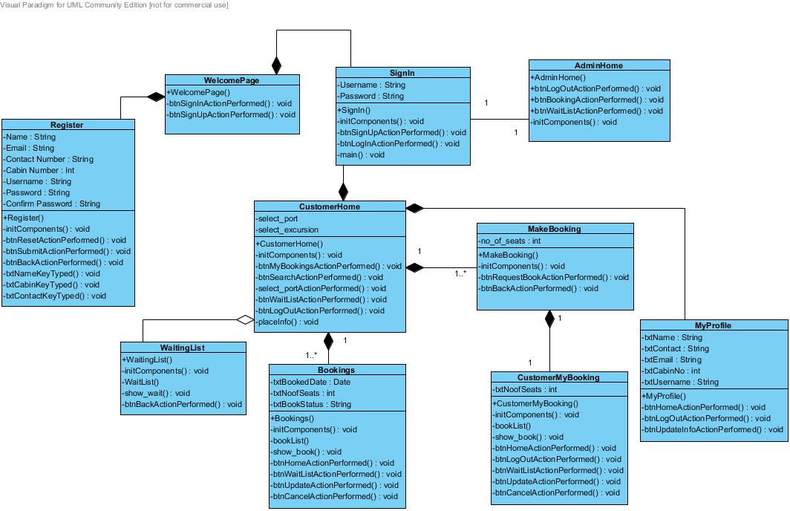
CLASS DIAGRAM

Slide 9
demonstration

Slide 10
THANK YOU

